Slide 1
Recent Progress in MPICH
Ken Raffenetti
Principal Software Development Specialist
Argonne National Laboratory

Slide 2

The MPICH Project
MPICH and its derivatives are the world’s most widely used MPI implementations
Supports all versions of the MPI standard including the recent MPI-3.1
Funded by DOE for 26 years
Has been a key influencer in the adoption of MPI
Award winning
project
DOE R&D100
award in 2005
MPICH and it derivatives in the Top 10
Summit (US): Spectrum MPI
TaihuLight (China): Sunway MPI
Sierra (US): Spectrum MPI
Tianhe-2A (China): MPICH-TH2
ABCI (Japan): Intel MPI and MVAPICH
Piz Daint (Germany): Cray MPI
Titan (US): Cray MPI
Sequoia (US): IBM PE MPI
Trinity (US): Cray MPI
Cori (US): Cray MPI
MPICH and its derivatives power 8 of the top 10 supercomputers (Jun. 2018 Top500 rankings)

Slide 3
MPICH: Goals and Philosophy
MPICH continues to aim to be the preferred MPI implementations on the top machines in the world
Our philosophy is to create an “MPICH Ecosystem”
TAU
MPE
PETSc
Intel MPI
RIKEN MPI
ADLB
HPCToolkit
Tianhe MPI
SunwayMPI
ParaStation MPI
MPICH
DDT
Cray MPI
FG-MPI
MathWorks
Totalview
Microsoft MPI
MVAPICH
ANSYS

Slide 4
MPICH-3.3 Features
New Device CH4: Low-instruction count communication
Thanks to Intel, Mellanox, and RIKEN for their significant contributions!
Very lightweight communication
Support for very high thread concurrency (partnership with Intel)
Improvements to message rates in highly threaded environments
Move from the LOCK/WORK/UNLOCK model to a scalable ENQUEUE/DEQUEUE model
Memory Scalability Optimizations
Hardware Acceleration for MPI Atomics
Scalable job startup
New Collective Infrastructure (partnership with Intel)
New collective algorithms, more comprehensive algorithm selection
Topology-awareness improvements
Fault tolerance improvements
Non-catastrophic errors and limited abort scope
CUDA-awareness for contiguous GPU buffers (partnership with Mellanox and NVIDIA)

Slide 5
MPICH layered structure: Current and Planned
MPI Layer
Platform independent code
Collectives
Communicator management
“Device” layer: Machine-specific functionality
Derived datatype management
RMA
CH3
psmpi
pamid
CH4
nemesis
sock
…
“Channel” layer
Some “core” functionality, such as shared memory
“Netmod” layer
Implements some mandatory functionality
Can override any amount of optional functionality (better bcast, better barrier)
tcp
mxm
ofi
ugni
…

Slide 6
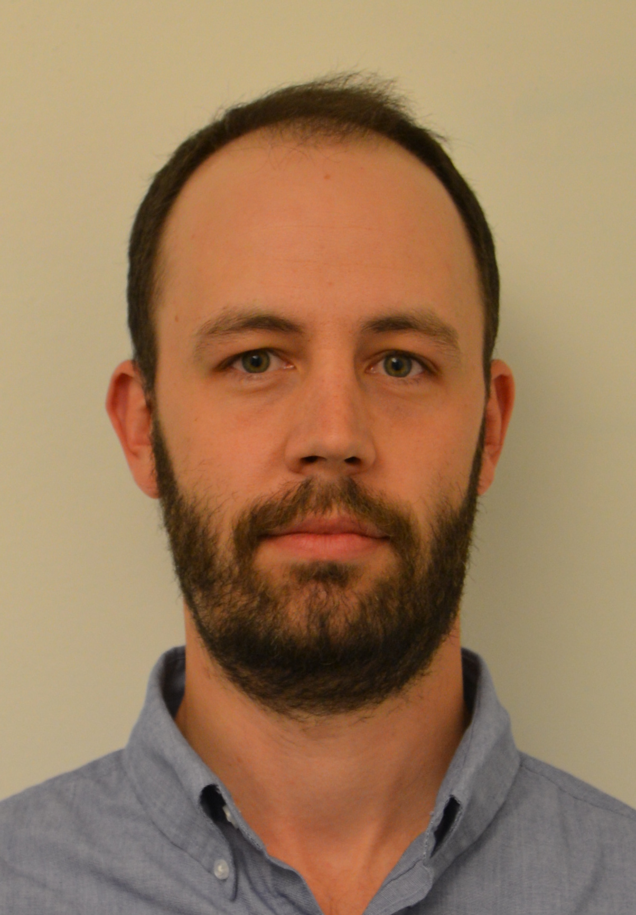
CH4 Design Goals
POC: Ken Raffenetti <raffenet@mcs.anl.gov>
High-Level Netmod API
Give more control to the network
netmod_isend
netmod_irecv
netmod_put
netmod_get
Fallback to Active Message based communication when necessary
Operations not supported by the network
“Netmod Direct”
Support two modes
Multiple netmods
Retains function pointer for flexibility
Single netmod with inlining into device layer
No function pointer overhead
MPI
CH4
Netmod
OFI
UCX
Portals 4
Provide default shared memory implementation in CH4
Disable when desirable
Eliminate branch in the critical path
Enable better tuned shared memory implementations
Collective offload
Minimal Per Process Data
Global address table
Contains all process addresses
Index into global table by translating (rank+comm)
Partnership with Intel, Mellanox, RIKEN

Slide 7
Lower Overheads = Better Strong Scaling
Nek5000 Mass−Matrix Inversion Efficiency
BGQ LAMMPS Strong Scaling MPICH/CH4 vs MPICH/Original

Slide 8

Improving MPI_THREAD_MULTIPLE
Leveraging hardware knowledge for scalable locking practices
MPI-knowledge driven thread synchronization
Work (e.g., message reception) driven thread reactivation on blocking operations
Prioritizing execution paths with the highest progress
POC: Halim Amer
<aamer@anl.gov>
3
O(1) wakeup of waiting threads
MPI_CALL_ENTER
Threads waiting for completion of pending operations
2
Path with low progress potential
MUTEX_LOCK
T0
Path with high progress potential
T1
Signal operation completion
NO
OPERATION COMPLETE?
MUTEX_UNLOCK
1
T2
YES
YIELD
T3
MUTEX_LOCK
MUTEX_UNLOCK
Synchronization counter
MPI_CALL_EXIT

Slide 9
Multithreaded MPI Work-Queue Model
Context
Existing lock-based MPI implementations unconditionally acquire locks
Nonblocking operations may block for a lock acquisition
Not truly nonblocking!
Consequences
Nonblocking operations may be slowed by blocking ones from other threads
Pipeline stalls: higher latencies, lower throughput, and less communication-computation overlapping
Work-Queue Model
One or multiple work-queues per endpoint
Decouple blocking and nonblocking operations
Nonblocking operations enqueue work descriptors and leave if critical section held
Threads issue work on behalf of other threads when acquiring a critical section
Nonblocking operations are truly nonblocking
MPI_Send(...)
{
CS_TRY_ENTER;
if(!success) {
CS_ENTER;
}
flush_workq();
Wait_Progress();
CS_EXIT;
}
Nonblocking
Operation
enqueue
Blocking
Operation
Dequeue
Tx
Tx
Work-Queue per
Communication Context
Partnership with Intel
Hardware

Slide 10
Interoperability with X Through User-Level Threads
MPI interoperates with shared-memory programming systems (X) either
Directly, if X is a threading runtime
Indirectly, through it’s threading runtime
MPICH can interoperate with/through the OS-level threading layer (e.g., Pthreads package) (heavy)
MPICH can also interoperate with X through the Argobots package (light)
Interoperation with lightweight threads allows
Better communication/computation overlapping
Reduced thread synchronization costs
Latency hiding of blocking operations
Applications
X
MPI
2
User-Level Thread Library (Argobots)
1
POSIX Threads (glibc)
1
2
Point-to-point latency with 36 Haswell Cores and Mellanox FDR
Proven better latency hiding than Pthreads-level interaction

Slide 11

Memory Scalable Network Address Management
AV Table: Compressing VC (480Bytes -> 12Bytes)
Compressing Multitransport Functionality
Function pointers are moved to a separate array
Deprioritizing Dynamic Processes
Process group information moved to COMM
Rank Mapping Models
Regular: DIRECT, OFFSET, STRIDE, STRIDE_BLOCK
Irregular: LUT, MLUT
Mixed: LUT_STRIDE, LUT_STRIDE_BLOCK, etc.
Shared AV Tables
AV Tables in shared memory for processes on the same node
Shared AV Table 0 (MPI_COMM_WORLD): created at init time, read-only, lock-free
Per-proc AV Tables (dynamic processes): avoid locking
POC: Yanfei Guo
<yguo@anl.gov>
DIRECT
COMM
OFFSET
COMM
STRIDE
COMM
LUT
COMM
MLUT
COMM
R=0
R=0
R=0
R=0
R=1
Offset
Stride
5
4
0:5
1:1
AV tables
0
1
2
3
4
5
0
1
LUT_STRIDE
COMM
Proc 0
Proc 1
5
4
R=0
R=0
Stride
COMM
COMM
…
R=0
0
1
2
3
4
5
0
1
2
3
4
5
Proc 0
Proc 1
R=0
R=0
…
COMM
COMM
SHM
0
1
2
3
4
5

Slide 12
Hardware Acceleration for MPI Atomics
Min Si
<msi@anl.gov>
MPI cannot naturally use hardware atomics for RMA accumulates:
Enabling SHM-based accumulates breaks atomicity with network hardware atomics
Mismatching between MPI semantics and hardware capability (e.g., maxloc, minloc)
Optimizations:
New info "disable_shm_accumulate":
Only use network-based atomics for accumulates in specific windows
New info "which_accumulate_ops":
Limit the need of atomic support at runtime
User specifies all accumulate reduce ops (e.g., "sum, replace") used over a window
Runtime queries their hardware support before communication in order to utilize hardware atomics if possible
Fetch_and_op(,...,MPI_NO_OP)
Window
use_hw_accumulate=true
which_accumulate_ops=sum, no_op
Network Module
SHM
if (support sum && fetch)
atomic_fetch(...)
Network
Hardware accelerated RMA atomics with info hints in NXTVAL* kernel on Theta/KNL (cache-quad)
* NXTVAL is the task scheduling module used in NWChem where every process issues MPI_Fetch_and_op to update a global counter with long type.

Slide 13
Scalable Job Startup
Using shared memory and MPI collectives to reduce startup time
Only node-root processes do PMI_KVS_Put
All processes on the node do PMI_KVS_Get into shared memory segment
No redundant lookups at the node level
Remaining business cards are exchanged with MPIR_Allgather using the node-roots communicator, again into shared memory.
BC exchange time reduced from 421 -> ~3 seconds on 1024 KNL nodes, 64 ppn on ALCF Theta (MPICH + OFI/gni)
Launch time of ~8 seconds on the full OFP machine (8192 KNL nodes/64 ppn)
POC: Ken Raffenetti <raffenet@mcs.anl.gov>

Slide 14

New Collectives Infrastructure
Thanks to Intel for the significant work on this infrastructure
Two major improvements:
C++ Template-like structure (still written in C)
Allows collective algorithms to be written in template form
Provides “generic” top-level instantiation using point-to-point operations
Allows device-level machine specific optimized implementations (e.g., using triggered operations for OFI or HCOLL for UCX)
Several new algorithms for a number of blocking and nonblocking collectives (performance tuning still ongoing)
POC: Taru Doodi
<taru.doodi@intel.com>
Contributed by Intel (with some minor help from Argonne)

Slide 15

Topology optimizations for MPI_Comm_split_type
MPI_Comm_split_type partitions a communicator into multiple comms
Takes a color argument and creates communicators with the same color
Communication local to the processes in the same communicator
Topology awareness: Communicator split such that the new communicators created are local to processes sharing hardware resources
User-provided info hints for shared memory optimization hwloc for bindset and topology queries
POC: Kavitha Madhu <kmadhu@anl.gov>
Rank 0
Rank 1
Rank 0
Rank 1
Color 0
MPI_Comm_split_type (color)
Communicator 1
Rank 2
Rank 3
Rank 0
Rank 1
Color 1
Communicator
Communicator 2
MPI communicator split with user defined color
Rank 0
Rank 1
Rank 0
Rank 1
Numanode 0
Numanode 0
MPI_Comm_split_type (Sharedmem, numanode)
Communicator 1
Rank 2
Rank 3
Rank 0
Rank 1
Numanode 1
Numanode 1
Communicator
Communicator 2
MPI communicator split for numa nodes
OSU Multi latency and Bandwidth tests on a single Skylake node
MPICH BoF (11/15/2016)

Slide 16
New Developments
Network Topology parsed using netloc, topology detection and classification at init time
Currently supported network toplogies: Fat tree, Torus
MPI_Comm_split_type arguments:
Shared memory key
Supported info hints:
Node level hints: Nodes, sockets (packages), numa nodes, cache
Network level hints: Switch level, torus dimension
Proximity hints: IO devices, GPU devices
Resource limit hints: Subcommunicator minimum size, Subcommunicator minimum memory size
Topology Detection Latency: Torus network
Topology aware Work stealing scalability and speedup with Fibonacci in one Skylake node
Topology aware Work stealing speedup with UTS on BG/Q
MPICH BoF (11/15/2016)

Slide 17
Fault Tolerance Improvements
POC: Yanfei Guo
<yguo@anl.gov>
Definition of Error Scope
Aborting applications is too expensive in large applications
To avoid always aborting an application, proposed work clearly defined the scope of error and added prototype implementation to allow error handler for only aborting connected processes in a sub-communicator
Non-catastrophic Errors
Defined the state of MPI after errors and identified non-catastrophic error such as resource exhaustions, shared memory allocation failure and no-async progress
A prototype implementation is carried out to handle non-catastrophic error
Allows user to change the # of requests than aborting
Rank 1
Rank 1
Communication error on subcomm of rank 1 and rank 2
Rank 2
Noncatastrophic
Error
.
.
Rank 2
.
.
.
.
MPI_Wait ()
Rank 0
.
.
Rank 0
.
.
.
.
# of requests > Total requests allowed
Local file read eror on Rank n-1
Rank n-1
Rank n-1
MPI processes do not abort on noncatastrophic error
Aborting MPI_Processes based on the location of error occurrence

Slide 18

CUDA Awareness
POC: Giuseppe Congiu
<gcongiu@anl.gov>
Enable use of CUDA buffers in MPI communications
Predefined and Contiguous datatypes supported through UCX
CUDA IPC and cudaMemcpy for intranode communication (multi-process/single GPU)
GPUDirect for internode communication
Partnership with Mellanox and NVIDIA
MPICH BoF (11/15/2016)

Slide 19
MPICH 3.4 Planned Features
Support for heterogeneous memory (e.g., MCDRAM)
Expanded CUDA-awareness (partnership with Mellanox and NVIDIA)
Reductions, RMA accumulate
Dataloop extensions and optimizations
Optimized code paths for common datatype compositions
Topology-awareness improvements
Virtual topology functionality, neighborhood collectives
Multi-WorkQ/Multi-VNI communication (partnership with Intel)
Utilizing network hardware parallelism, MPI Endpoints prototype
ULFM Prototype
Hydra rewrite (partnership with Intel)
More scalable launch, optimized internal protocol

